Slide 1



PROJECT 3
PROJECT PRESENTATION
Guided by :-
Mr. Prakash Agarwal
Mr. Shreysh Mane

Slide 2
OUR TEAM
Sashikala
Swapnil
Gourab
If everyone is moving forward together, then success takes care of itself.
MD Raza
Abhijeet
Yashwanth
Sandhya
Vijay
Sanjay
Uday
Sayali
Abhishek
Abhishek
Emmy
Amol
Bhushan
Gayatri
Harshada
Krishnakanth

Slide 3


What is ….?
ServiceNow is a cloud-based workflow automation platform that enables enterprise organizations to improve operational efficiencies by streamlining and automating routine work tasks.

Slide 4

INTRODUCTION
This is our Project 3 Presentation in which we have Modified Incident , Problem , Change & Service Catalog Applications.

Slide 5
OBJECTIVES OF THIS PROJECT
Our Major Objective was to Revise & Implement all the Topics which were Covered in our Training.
To Modify our Instance & Implement Logical Changes in our Assigned Applications.
Final Objective as of our Project was to Work in Group & Learn how to work as an Team.
We have Modified our Incident ,Problem, Change, & Service Catalog Module as per our FRS.
We have Learned the Modules Throughly after Successful Implemenation of the Project.

Slide 6
TABLE OF CONTENTS
Incident
Problem
01
02
Change
Service Catalog
03
04
Incident Management in ITIL
Problem Management in ITIL
Change Management in ITIL
Service Catalog to Order an Item

Slide 7
01
Incident Management
Incident management is the practice of minimizing the negative impact of incidents by restoring normal service operation as quickly as possible.

Slide 8
Agenda
What is Incident Management .
Why Incident Management .
Incident Application & modules.
How to Create an incident.
Incident Management Configuration.
Customizing the Existing form.
Designed Incident Management.

Slide 9
What is Incident Management ?
Any disruption to the service is referred to an Incident.
The goal of Incident Management is to restore normal service operation as quickly as possible.
The Service-Now platform supports the Incident.
Management process with capabilities to record
incidents , classify according to impact and
urgency.

Slide 10
Why Incident Management….?
To restore services back to normal operation as fast as possible.
To mitigate the adverse effect of critical incidences on business operations.
Incident management as the name suggests is the process that is used to manage the lifecycle of all incidents.
Enhance and maintain user satisfaction without losing the quality of IT services.

Slide 11
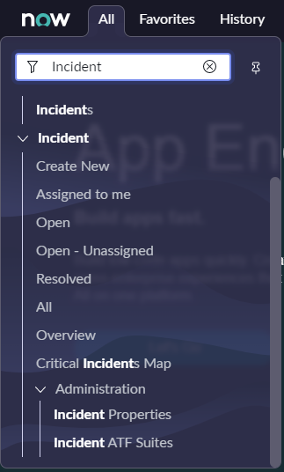
Incident Management Application
1.Module 1 : Create New
Using this we can create new incident.
2.Module 2 : Assigned to me
Using this we can assign an
incident.
3.Module 3: Open
Using this we can open an incident.

Slide 12
Incident Management Application
Module 4 : Open-Unassigned
Unassigned incident used to assign, reassign, edit or promote to a major incident.
Module 5: Resolved
When the service is restored by rectifying the issue that resulted for an incident, you can set the incident state as resolved.
Module 6: All
All displays a list of all records from the incident table.

Slide 13
Incident Management Application
Module 7 : Overview
It will show us overview of incident.
Module 8: Critical Incidents
Map
Critical incident map will be using the latitude and longitude to identify a location.

Slide 14
Create a New Incident
Number : Number of incident.
Company : Purpose of company is to knowing the company of caller who has raised the incident.
Caller : Caller is the user on behalf of whom the incident is being reported.
Location : Location field pre-fills with the registered location of the user.
Department : You just simply need to add the department field from the caller reference fields.
Phone : When a user enters a phone number, it is received and stored as a string of numbers.
Category : Categorization of incidents helps in routing to the right team and saves a lot of time.

Slide 15
Create a New Incident
Subcategory : In category subcategory is there.
Configuration item : It has a configuration dictionary level that it depends on the company field.
Impact: It is designed to close the value gap.
Urgency: It measure how long resolution can be delayed until an incident has a significant business impact.
Priority: It will change when impact and urgency change.
Short description: It is for a short description of the task.
Description: It is for a more comprehensive explanation of the issue.

Slide 16
Create a New Incident
Opened : It is populated with the timestamp that a user opened the ticket for the first time client side.
Opened by : It is the user who is actually creating the incident.
Channel: Mode of the communication.
State: It could contain choices that can be consistent across all forms.
Assignment group: It is a list of users who are responsible for an incident record.
Assigned to: It is a reference field type that points to the users table.

Slide 17
Incident Management Configuration
Caller :-
Caller is the user on behalf of whom the incident is being reported.
Category :-
Category to assign incidents to the correct team and save time in troubleshooting and bringing the service to normalcy.
Subcategory :-
Each category has the subcategories.

Slide 18
Incident Management Configuration
Impact:-
Impact is designed to close the value gap with personalized recommendations.
Urgency:-
Urgency is a measure how quickly a resolution of the incident is required.

Slide 19
02
Problem Management
Problem management is a core component of the ITSM framework, and is the process for identifying and managing root causes and potential IT incidents.

Slide 20
Agenda
What is Problem Management.
Why Problem Management.
Problem Application & Modules.
How to Create an Problem.
Problem Management Configuration.
Customizing the Existing form.
Designed Problem Management.

Slide 21
What is Problem Management ?
Incidents, and minimize the impact of incidents which cannot be prevented. Provide operational transparency with role-based dashboards for problem managers and coordinators. Identify and remediate abnormal patterns and trends before they become problems. Problem Management is available with IT Service Management. Transform the impact, speed, and delivery of IT.
Problem management is an approach that is designed to effectively manage the life cycles of current and potential issues. The goal of problem management is to eliminate recurring incidents, prevent future.

Slide 22
Why Problem Management….?
Problem Management makes it possible to identify the root cause of an issue that is affecting your services and can help you prevent issues from happening in the first place. With a structured workflow for diagnosing root causes and fixing problems, ServiceNow empowers you to eliminate recurring incidents and minimize the impact of unexpected disruptions.
Allow problem managers to easily document workarounds and solutions, so IT teams can focus and get more done. With a consolidated view of the incidents and related changes, IT can deliver faster responses and solutions.

Slide 23
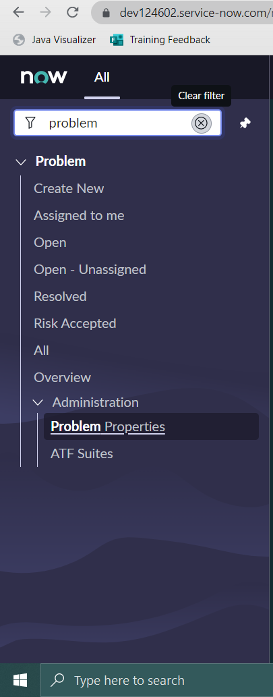
Problem Application & Modules
Problem Management helps your personal to record resolutions and make them easily available to affected user groups, to react more reactively resolve issues before incidents occur.
Module 1 Create new:-It allows you to create a new quickly to issues related to incidents, and to problem
Module 2 Assigned to me:-It shows the problem assigned to me
Module 3 Open:-It allows you to open existing problem in list view.

Slide 24
Problem Application & Modules
Module 4 Open-Unassigned :- It opens the list view of problems which is not assigned to anyone.
Module 5 Resolved :- It opens the list view of resolved problems.
Module 6 Risk accepted :- It opens the list view of problems which accepts the risk.
Module 7 All: - It opens the list view of all state of problems.

Slide 25
How to create Problem…?
Create a Problem by Clicking Navigate to Problem > Create New.
Fill the Form.
Click the Notes tab , to enter work notes for the problem,(When you initially create and save a problem, entering notes in the Work notes field is not mandatory. If you change the priority of the problem by selecting different Impact or Urgency values on an existing problem, the Work notes field becomes mandatory).
Click the Closure Information tab and enter the information, (The date on which the problem was closed and the user who closed it populate automatically).
Click Submit.

Slide 26
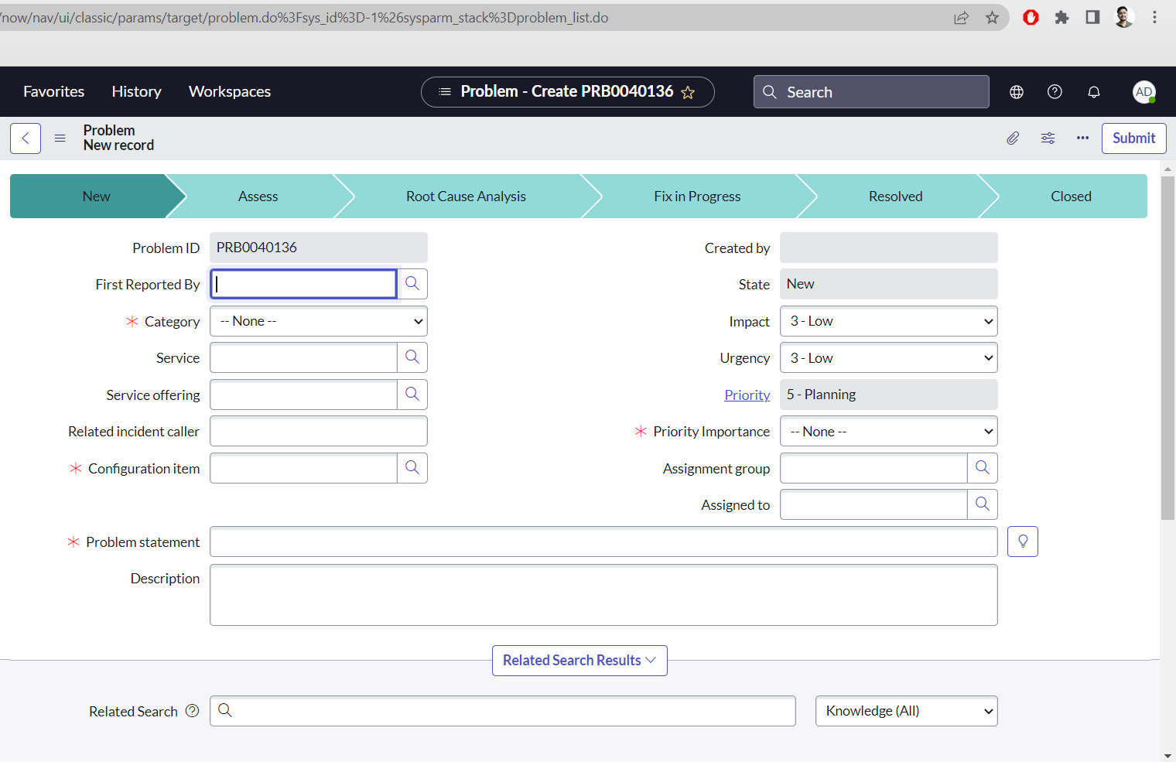
Problem Management Configuration

Slide 27
Problem Management Configuration
Problem id:-Problem id is the number given to the problem and it is auto populated.
First reported by:- Enter the incident number that first identified the problem. Multiple incidents can be related to the problem later in the record.
Category:- Use the drop down menu to select the required Category.
Service:- Affected system or service. Start typing the system or service name and select from the list of results. Or use the magnifying glass for further search options.
Service Offering:- Field not currently in use (leave blank),

Slide 28
Problem Management Configuration
Configuration Item:- Configuration item affected.
State:- The state of the problem is visible from the header of the record. It is automatically updated when the Assess, Confirm, Fix, Resolve and Complete actions are used to progress the problem and further detail is documented and saved within the record.
Priority:- Priority of the problem according to impact and urgency (amend as required).
*Assignment group:- Start typing the name of the assignment group that will own the problem and select from the list of results. Or use the magnifying glass to select from the list of groups.

Slide 29
Problem Management Configuration
Assigned to:- Enter the name of the person the problem should be assigned to. Or use the magnifying glass for further search options. Alternatively this can be left blank if the group's dispatcher should be responsible for assigning the problem.
*Problem statement:- Short description of the problem.
*Description:- Full description of the problem.
Notes:-
Work notes list Select the padlock to add users to the watch list for this problem.
Select Add me button to add yourself to the watch list.
Select the padlock to add users to the watch list for this problem.

Slide 30
Problem Management Configuration
Select Add me button to add yourself to the watch list.
Work notes Free text documenting how the problem is progressing.
Analysis Information:-
Primary Known Error article Primary Known Error article related to this problem
Workaround Details of the workaround currently in place whilst the root cause is being investigated,
Cause notes Details of the root cause once identified.
Resolution Information:-
Resolved by Name of the person who resolved the problem
Resolved Date the problem was resolved.

Slide 31
1.UI Policies:- 17 2.Client Scripts:- 11 3.Business Rules:- 5 4.Notifications:- 7 5.UI Actions:- 2 6.By using Form Design:- 8(Making Fields Mandatory)
Scripts Used

Slide 32
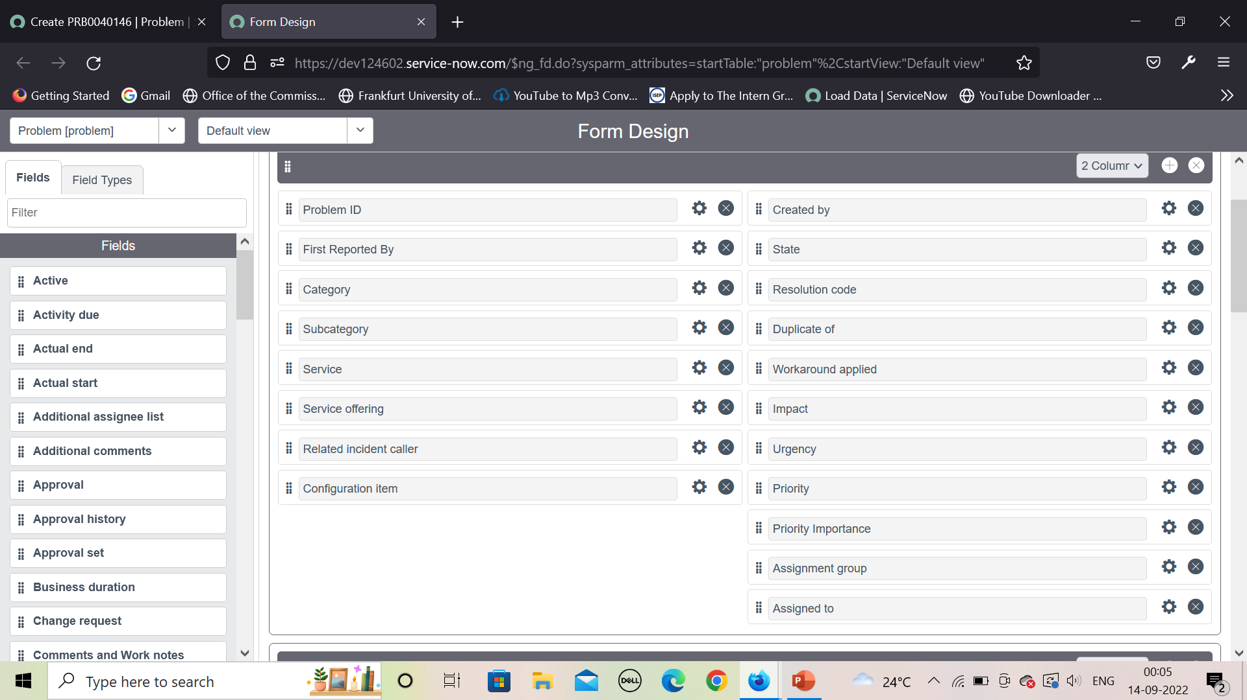
Design Problem Management

Slide 33
03
Change Management
Change Management in ServiceNow involves the provision of a systematic approach to control the life cycle of all changes, facilitating beneficial changes to be made with minimal disruption to IT services.

Slide 34
Agenda :
▪ What is Change Management.
▪ Types of Change Management.
▪ Change Functionality
▪ Scripting Included

Slide 35
What is Change Management
• The IT Service Management (ITSM) solution provides scalable workflows to manage and deliver IT services to your users all through a single cloud-based platform.
• The ServiceNow Change Management application provides a systematic approach to control the life cycle of all changes, facilitating beneficial changes to be made with minimum disruption to IT services.
• IT Change Management is the IT service Management (ITSM) process that helps to follow standard procedures and practices for effectively managing requests to drastically minimize the risk and disruptions a change can have on IT and business operations.

Slide 36
Types of Change Management
Standard Change
A standard change is a pre-authorized change that is low risk, relatively common and follows a specified procedure or work instruction. These change requests are accessed through their own module in the left navigation.
Normal Change
Any service change that is not a standard change or an emergency change. Normal changes are often categorised according to risk and impact to the organisation/business.

Slide 37
Emergency Change
A change that must be implemented as soon as possible, for example to resolve an incident stopping service or to implement a critical security patch. This change is of such a high priority that it bypasses group and peer review and approval and goes straight to the Authorization state for approval by the Change Advisory Board.
Major Change
A major change will substantially change the business operations. Because of the impact of the change, the planning stage is vast and more detailed than would be possible at the initial creation of the request. The Major Change Module expands the planning section by creating tasks for Implementation Plan, Risk and Impact Analysis, Backout Plan and Test Plan.

Slide 38
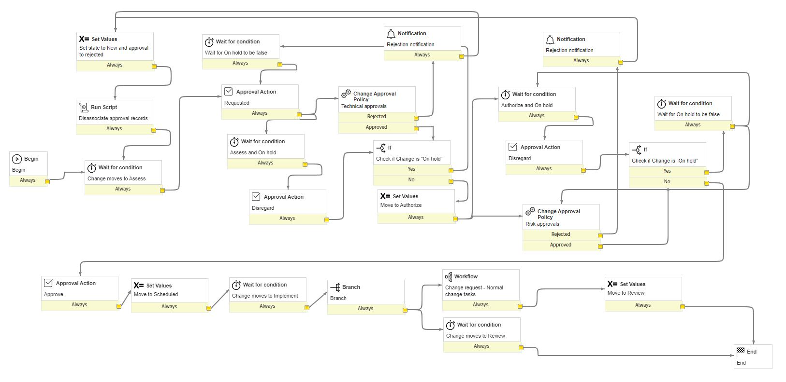
Workflow (Major):

Slide 39
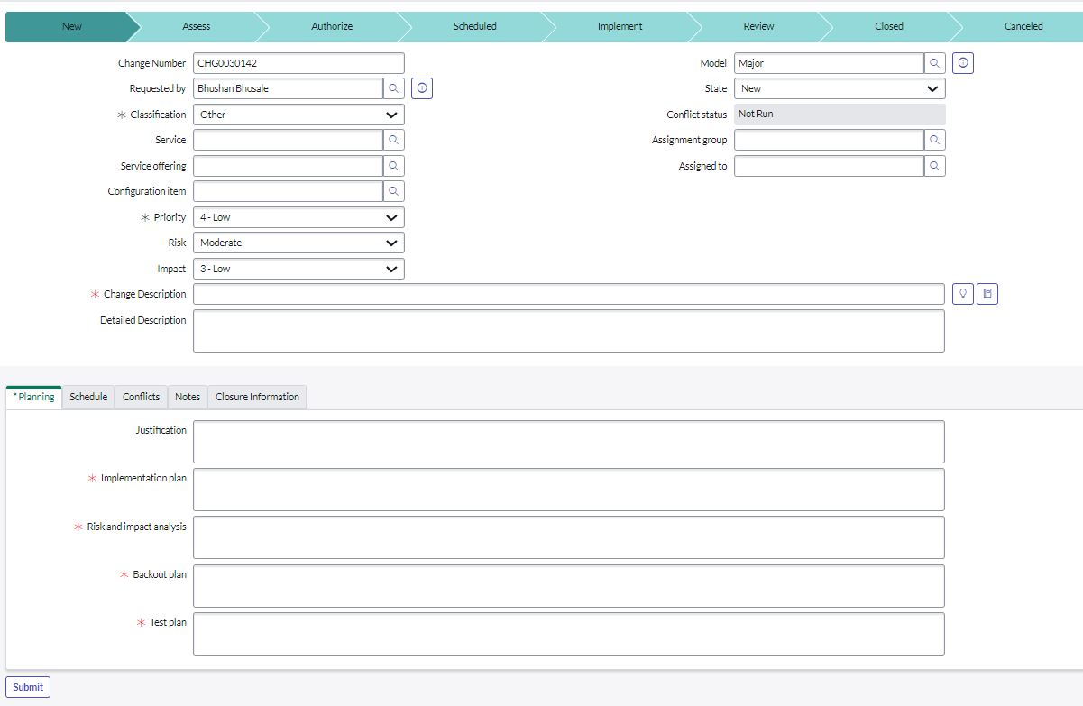
Change Form

Slide 40
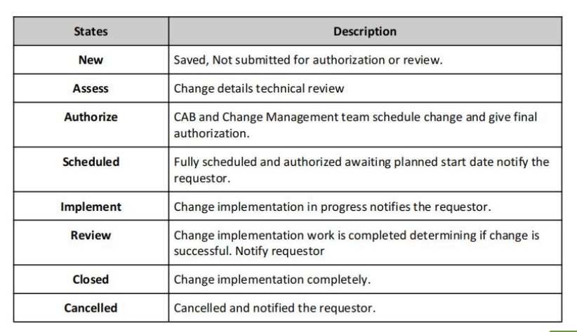
Change Functionality

Slide 41
Change Management Application and Modules
The ServiceNow Change Management application provides a systematic approach to control the life cycle of all changes, facilitating beneficial changes to be made with minimum disruption to IT services.
To access the modules for Change Requests you must enter change into the application navigator. Once entered it will give you access to the change application. In the change application it has many modules including Create New, Open, Closed, All, Standard Change, ChangeAdvisory Board, and etc.

Slide 42
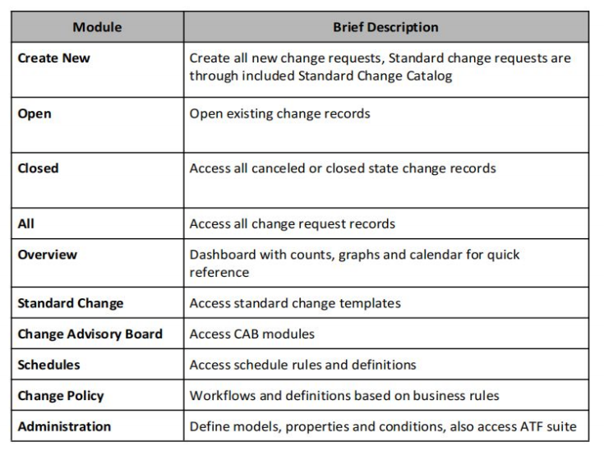
Change Management Application and Modules

Slide 43
Scripts Used
Client Scripts
Script Includes
Business Rules
UI Policy
UI Action
Workflow Scripts

Slide 44
04
Service Catalog
A service request may be defined as a formal request for service from an employee, customer, or vendor.

Slide 45
Agenda
What is Service Request ?
Why is Service Request Important ?
Examples of Service Request
Service Request Application & modules.
Request Management Architecture
What is Service Catalog?

Slide 46
What is Service Request ?
A service request may be defined as a formal request for service from an employee, customer, or vendor.
These requests are necessary for initiating a pre-defined and agreed-upon service action as a normal part of service delivery.
Service request is not for help. Service request is ordering something(software, new desktop, access to system, system privileges).

Slide 47
Why Service Request….?
To support the agreed quality of service by handling pre-defined services.
Necessary to fulfilment of a request like ordering laptop or as business needs requests.
Important to track service request like who will approve and who will fulfil Catalog task.

Slide 48
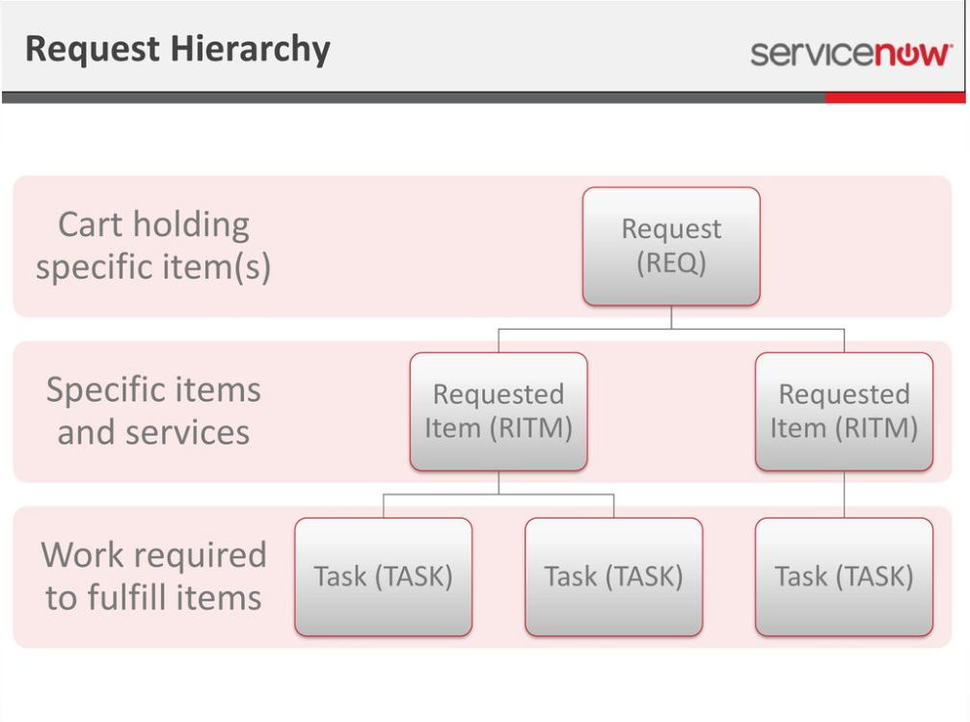
Request Management Architecture

Slide 49
Examples of Service Request
May take many different forms depending on the services being offered by provider.
Some Common examples:
1)Time-off request:
vacation or otherwise schedule time off work from HR Department.
2)Purchase order authorizations:
Business that rely on goods or services from third party.
3) Password Reset:
Request for resetting password.
4) Content – creation:
Related to Marketing, such as advertising, internal materials.

Slide 50
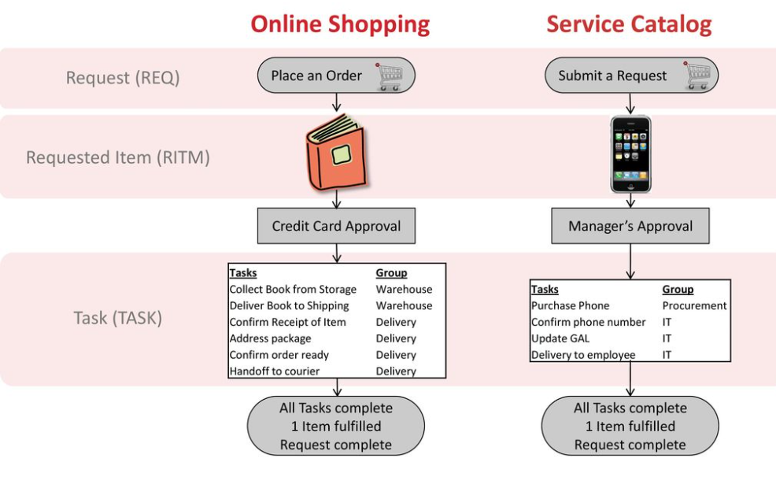
Examples of Service Request

Slide 51
What is Service Catalog ?
Catalog to provide users with self service options.
Portal Where users can request different services provided by different business unit in organization
Used to support request management
Service request is generated with the help of service catalog.

Slide 52
What is Request Items ?
Request Items (RITMs) contain the actual form the customer submitted and links to one or more tasks required for fulfilment.
RITMs can be assigned to a fulfilment group, not an individual.
Fulfillers will rarely need to interact with a RITM, but do have the ability to add comments and work notes if applicable.
Status changes should be updated at the task level, not the RITM. RITMS should never be manually moved to a different Request.

Slide 53
What is Catalog Task ?
Tasks are tied to RITMs. Tasks can be assigned to an individual for completion. In most cases, fulfillers will interact directly with the Task.
All status updates should be made on the Task, not the RITM. Tasks should never be manually moved to a different RITM.
Once each task on a RITM is completed and marked as closed, the RITM will automatically be closed.
Once all RITMs on a request are closed, the Request will automatically close.

Slide 54
THANKS
Do you have any questions?

